Slide 1

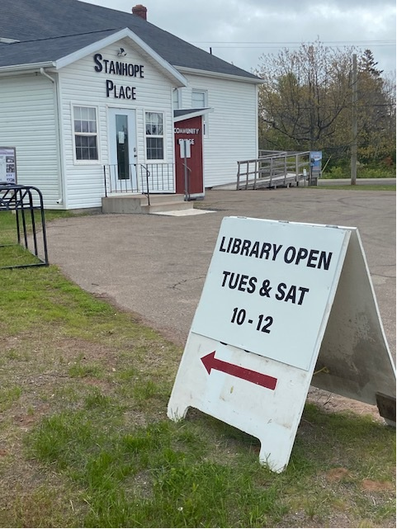
North Shore Community News – Spring 2026
We are happy to present our new and improved newsletter. We would also like to thank our community for attending our fall and winter events including Remembrance Day, our Christmas and Easter celebrations, each of which attracted more than 100 participants.
The Rural Municipality of North Shore is committed to giving back to the community.
Stay tuned for upcoming events!
2120, RTE 25
West Covehead, PE C0A 1P0
(902) 672-2600​
www.northshorepei.ca
Volunteers needed!
Stanhope Place Library
Got a little time?
Use it to do something big. Join our volunteer team and help support the work that keeps our community thriving.
NEW LIBRARY HOURS!
NOW OPEN TUESDAY & SATURDAY
10-12
NO LIBRARY CARD NEEDED

Slide 2
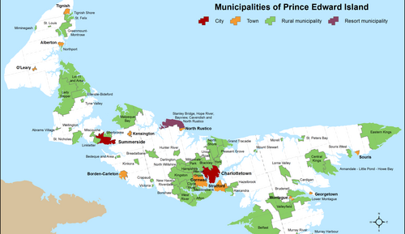
Municipal Council
Watts, Gerard
Paquet, Melissa
McLaine, Peter
Sheehan, Charity
Doyle, Bob
Cook, Derek
MacKinnon, Nancy
Mayor
Councillor Ward 1
Councillor Ward 2
Councillor Ward 3
Councillor Ward 4
Councillor Ward 5
Deputy Mayor Ward 6
Mayor and Council (we) are cooperating on research with Dr Sarah Stewart Clark of Dalhousie University, the watershed groups, oyster and mussel fishermen on sea plants and species at risk in Covehead, Tracadie and Brackley Bays.
In addition, we have engaged with Dalhousie Researcher Dr Barret Kurylyk, who has recently undertaken to measure saltwater to freshwater delineation in Stanhope Peninsula. Dr Kyle Kynysh of the PEI Department of Environment and Climate Action continue to undertake water quality testing in the various estuaries in the Municipality.
Research results will be presented at the fall session of the Council.
2026 Municipal election year​
Date: November 2, 2026
(province‑wide for all municipalities). Positions elected: Mayors, councillors, and other municipal officials across all PEI municipalities.
Who can run for municipal office?
You can run for municipal office if you:
Are a Canadian citizen
Are at least 18 years of age or older
Have been ordinarily a resident in the municipality for a period of at least six months before the election
You want to make a difference in your community, now’s your chance!
FOR MORE INFORMATION, PLEASE CONSULT THE
FOLLOWING MUNICIPAL ELECTIONS WEBSITE
Municipal Elections PEI | Municipal Elections

Slide 3


CANADA DAY
Come and celebrate Canada Day with us on July 1st at the North Shore Community Center
From 1:00 to 3:00 pm
Enjoy cake and ice cream with games, face painting and balloon twisting and much more.
Then joins us for fireworks in Grand Tracadie at 10:00pm!
FLEA MARKET – June 20th and 21st
Thank you to everyone who reached out and showed interest in our Flea Market. We’re thrilled to share that, thanks to the great response, the event is officially moving ahead and will take place on June 20th from 9am to 3pm and June 21st 9am to noon.
We’re also looking to welcome more homemade and locally crafted goods. If you — or someone you know — creates art, crafts, baked goods, or other handmade items and would like to reserve a table, please get in touch with Recreation at 902-672-2600.
Table reservations are $20 each, with a deadline of June 6th. E‑transfer payments can be sent to:
administrator@northshorepei.ca
This Photo by Unknown Author is licensed under CC BY-SA

Slide 4

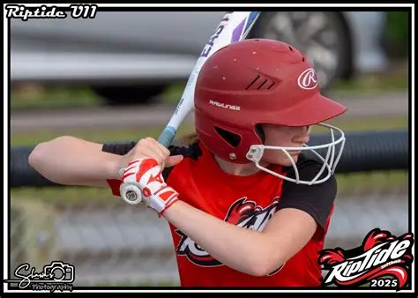

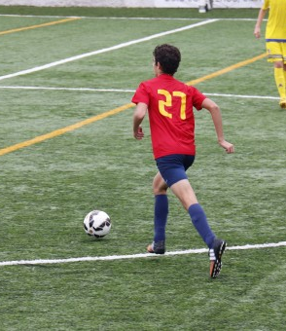

Its registration time!
The Softball league is now accepting registrations. Please visit their website to sign-up or E-mail.
www. riptidesoftball.ca
riptidesoftballassociation@gmail.com
The North Shore Sharks soccer league is lookings for players of all ages.
To register, visit their website:
North Shore Sharks Soccer Club : Website by RAMP InterActive

Slide 5
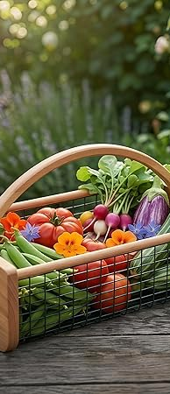
Community Gardens
Community Fridge
To register call
902-672-2600
Because Eating shouldn’t be a choice you have to make
Since 2023, North Shore has made available a stocked-up refrigerator with a pantry to help our residents in need, and it is located at Stanhope Place.
How does it work?
The Municipality, through a grant from the province, gets fresh produce and staple pantry items, stores them throughout the year and makes them available to our community year-round.
North Shore is launching a new initiative in the form of elevated garden boxes. Residents are encouraged to register to reserve one for the summer by calling at 902-672-2600.
Numbers are limited.
The boxes will be at three locations, Stanhope Place, The HomeStead Retirement Home and Grand Tracadie.
All registered participants will be invited to attend several garden information sessions to learn about gardening in a box and harvesting.
Fresh produce baskets
But a community Fridge is a give and take process and a community effort. What we would like to see in the future is for the residents of the Rural Municipality of North Shore to bring perishables and nonperishables to the pantry and Fridge to help other residents in need throughout the year.
We’re excited to share that we will be offerings baskets filled with fresh items from local farmers and producers.
They will be available every second week, with pickup alternating between Stanhope Place and the North Shore Community Centre. Quantities are limited.
To sign up for a basket, call 902 672 2600.

